Slide 1




Unlocking Insights 2.0:
A Cutting-Edge Approach to Sell-Side Equity Research with Advanced Machine Learning Models
Group 5

Slide 2

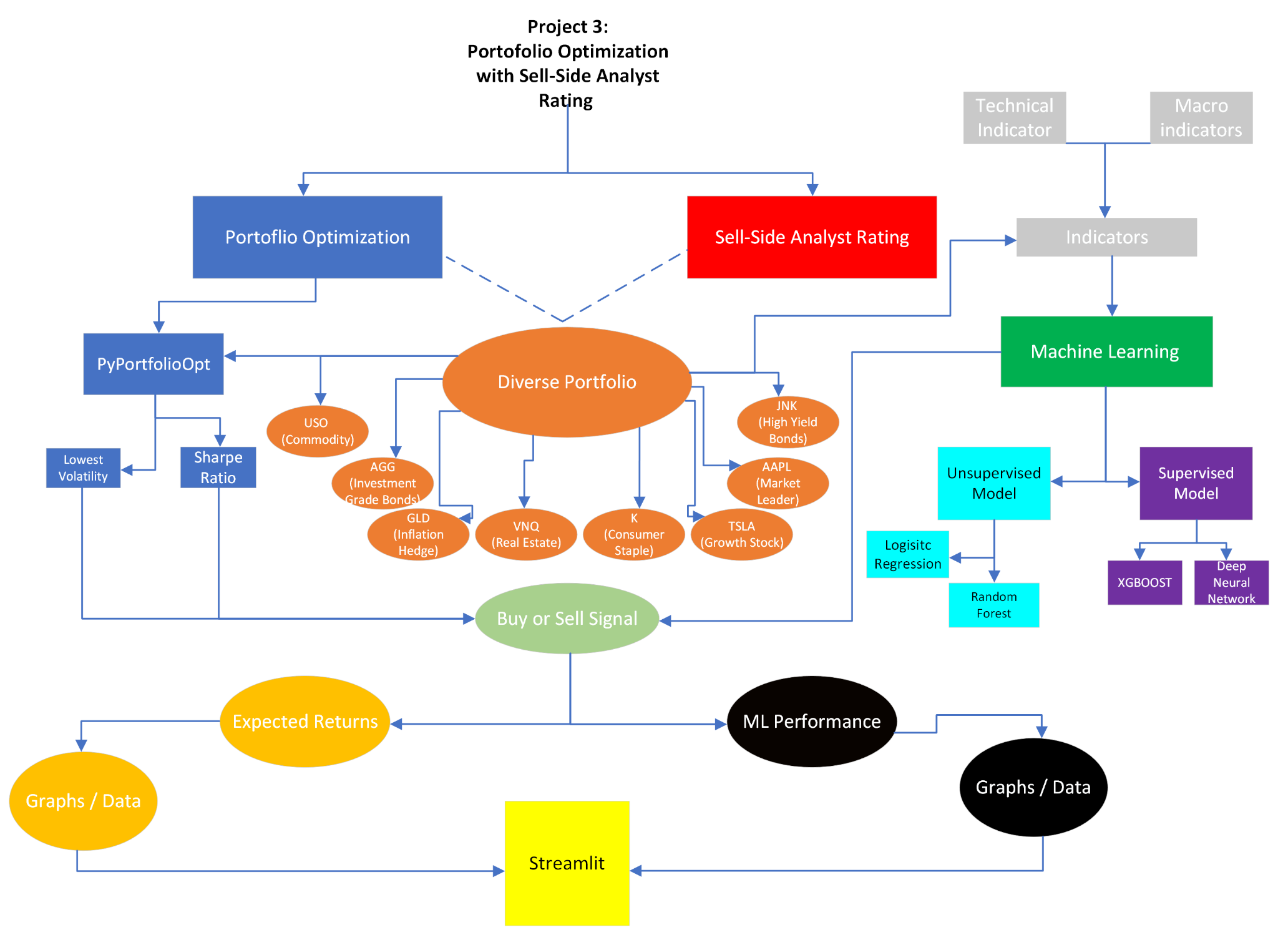
Notes:
Alex

Slide 3
Introduction:
Eight Assets
GLD
Inflation
VNQ
Real Estate
USO
Oil Commodity
K
Consumer Staple
AAPL
Market Leader
TSLA
Growth Stock
AGG Investment Grade Bonds
JNK
High Yield Bonds
Two Categories of Indicators:
Technical Indicators
Macro Indicators
Four Predicted Machine Learning Models:
Random Forest
Logistic Regression
Neural Network
XGBoost
Two Portfolio Options
Sharpe Portfolio
Minimum Volatility (Low Risk)
GOAL: Determine the efficacy of our Portfolio’s Buy/Sell signal utilizing
Machine Learning
Notes:
Alex

Slide 4
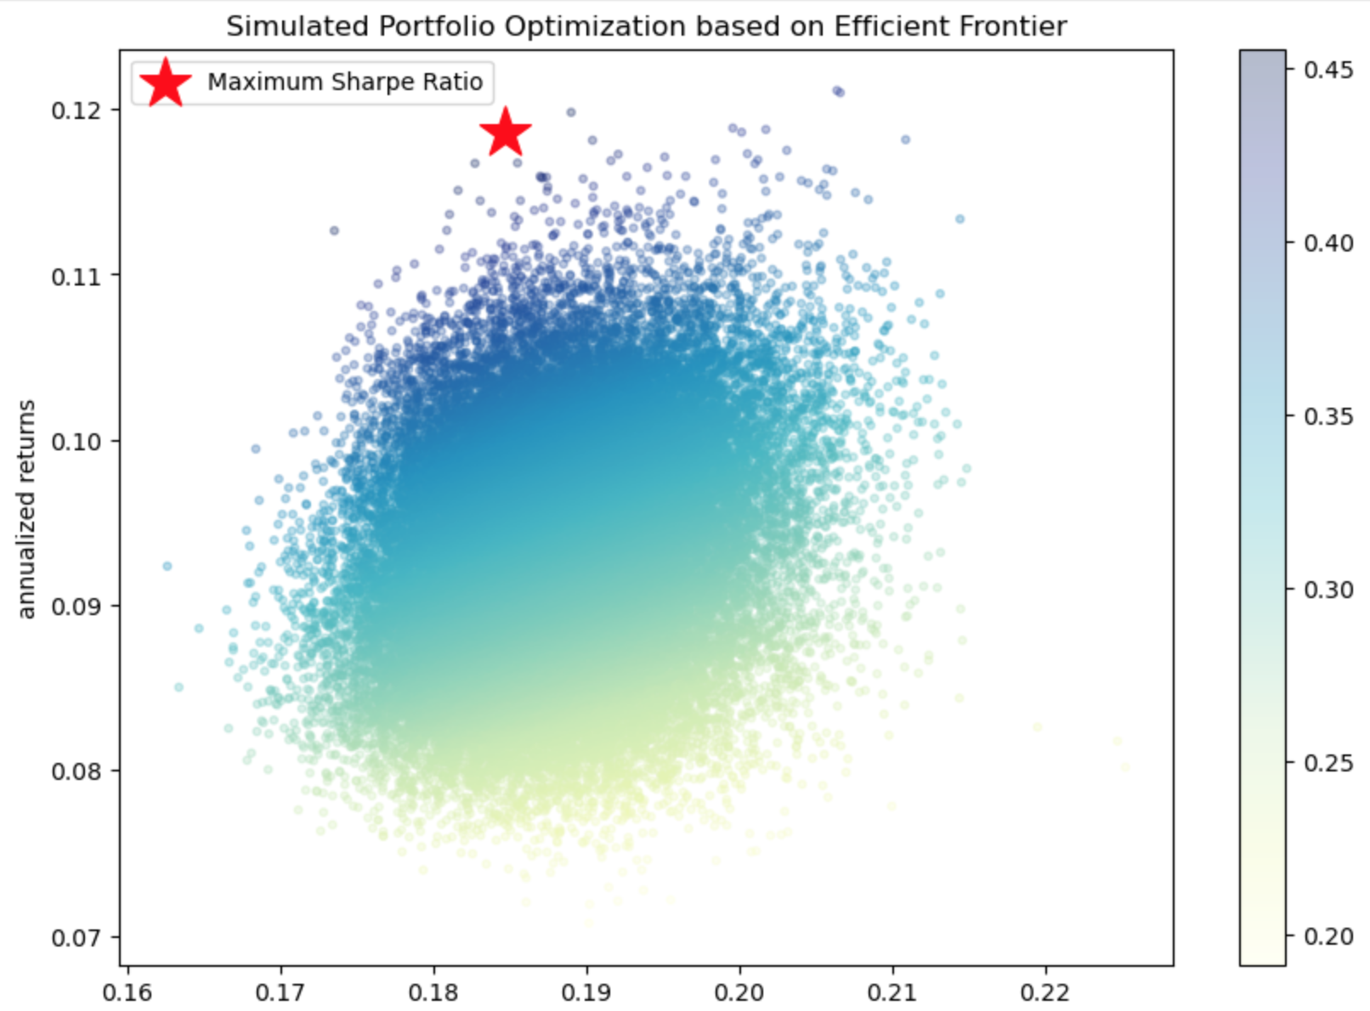
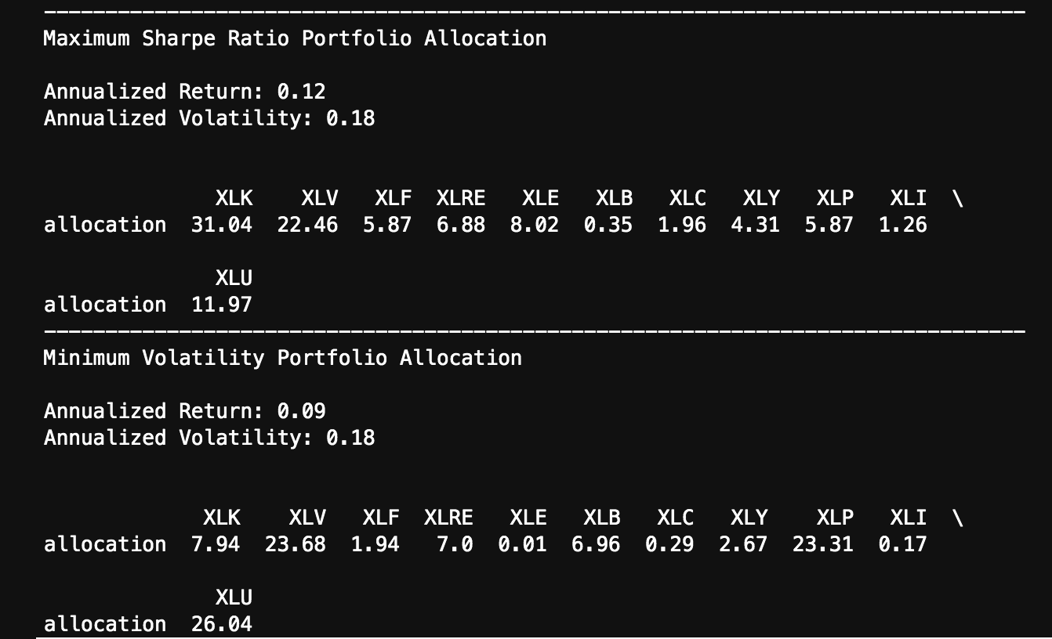
Efficient Frontier 1.0
Notes:
Alex

Slide 5
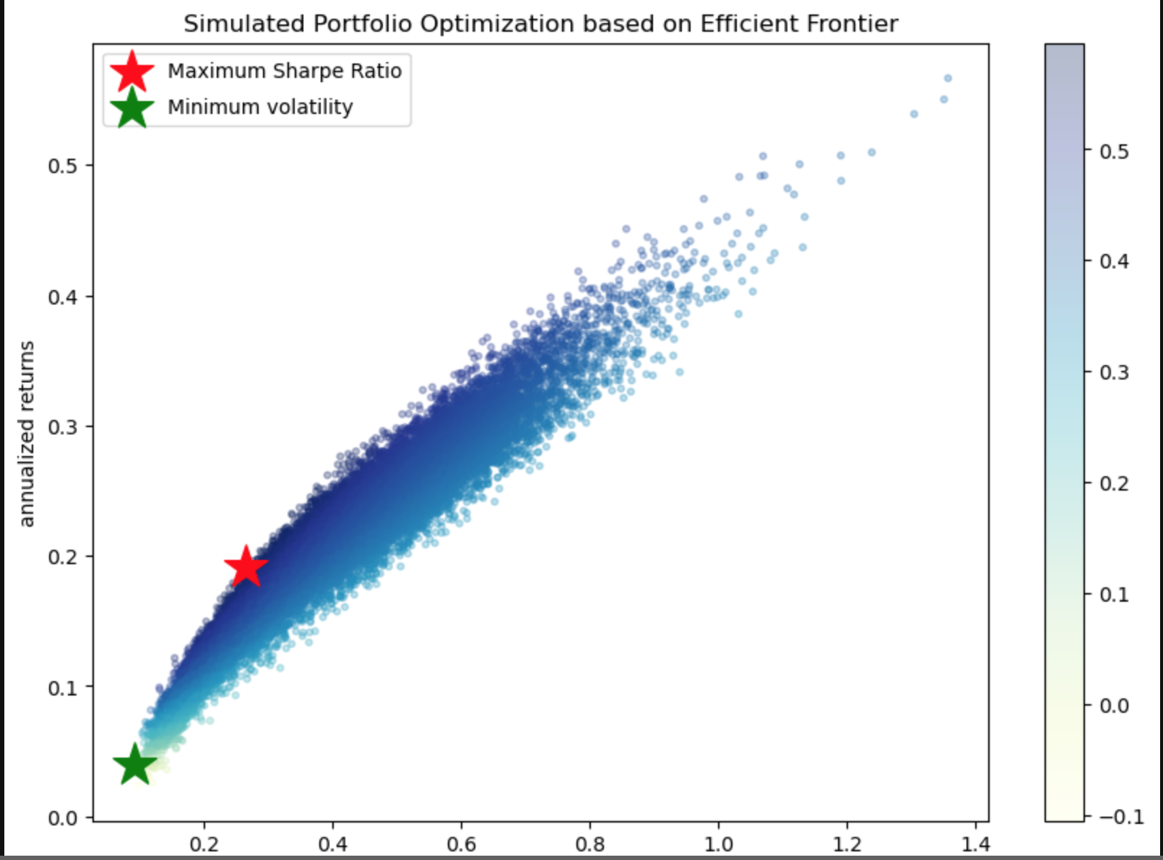
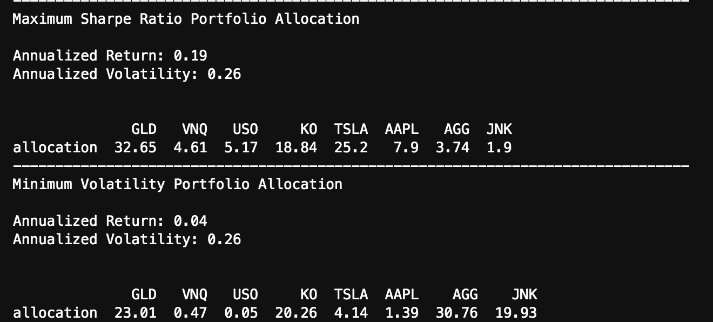
Efficient Frontier 2.0
Notes:
Alex

Slide 6


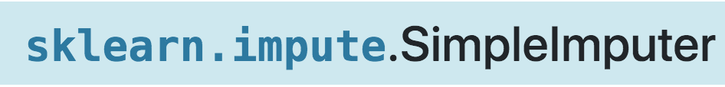
Data Preparation & Model Training Process of new dataset
Notes:
Alex

Slide 7

Data Preparation: Sharpe Ratio
Signal is based on the the percentage change for each asset, and multiplied by each respected weight (determined by the Modern Portfolio Theory). Assets were then totaled:
% Change > 0 = BUY
% Change <= 0 = SELL
Notes:
Alex

Slide 8

Data Preparation: Minimum Volatility Portfolio
Signal is based on the the percentage change for each asset, and multiplied by each respected weight (determined by the Modern Portfolio Theory). Assets were then totaled:
% Change > 0 = BUY
% Change <= 0 = SELL
Notes:
Alex

Slide 9
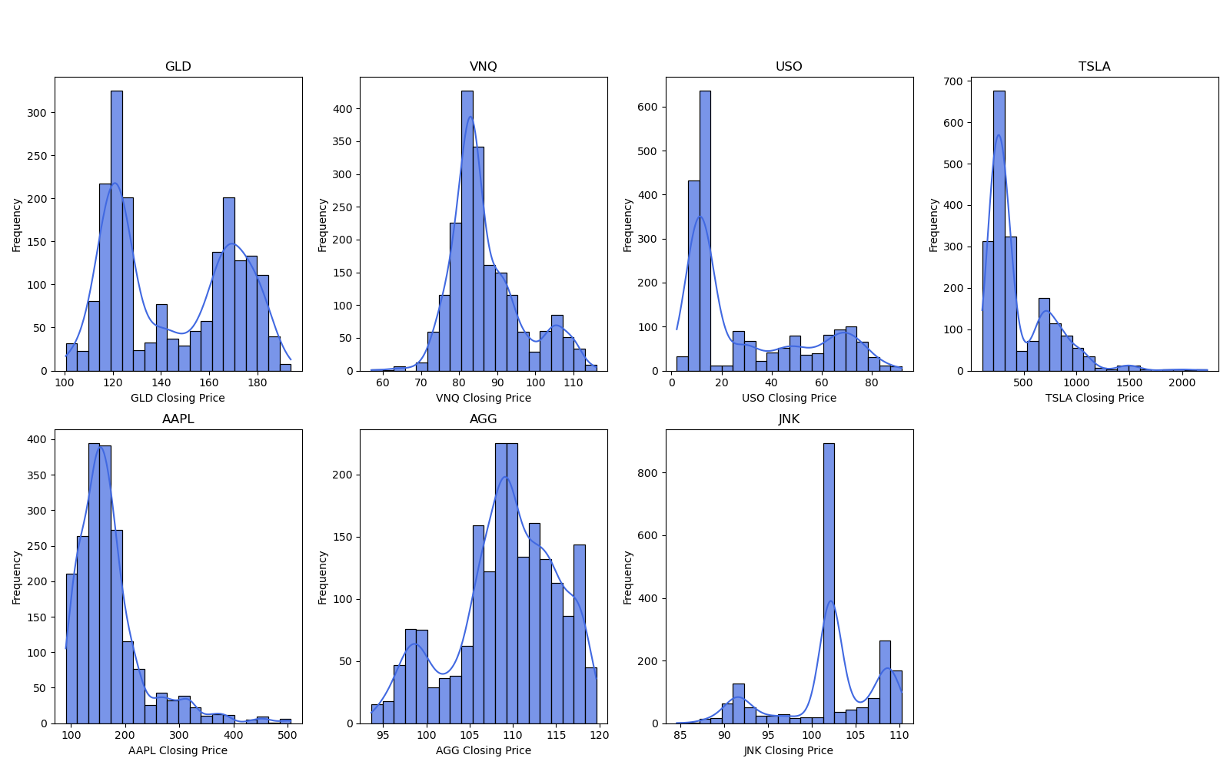
Distribution of Key Variables
Visual exploration of relationships and trends between pairs of variables
GLD (Gold) and AGG (Aggregate Bond) exhibit smooth distributions, while TSLA (Tesla) and AAPL (Apple) display varied distributions
GLD and AGG exhibit a positive linear relationship, representing a potential safe haven for market uncertainties
USO (Oil) and VNQ (Real Estate) show dispersed points, suggesting volatility
Notes:
Justin

Slide 10
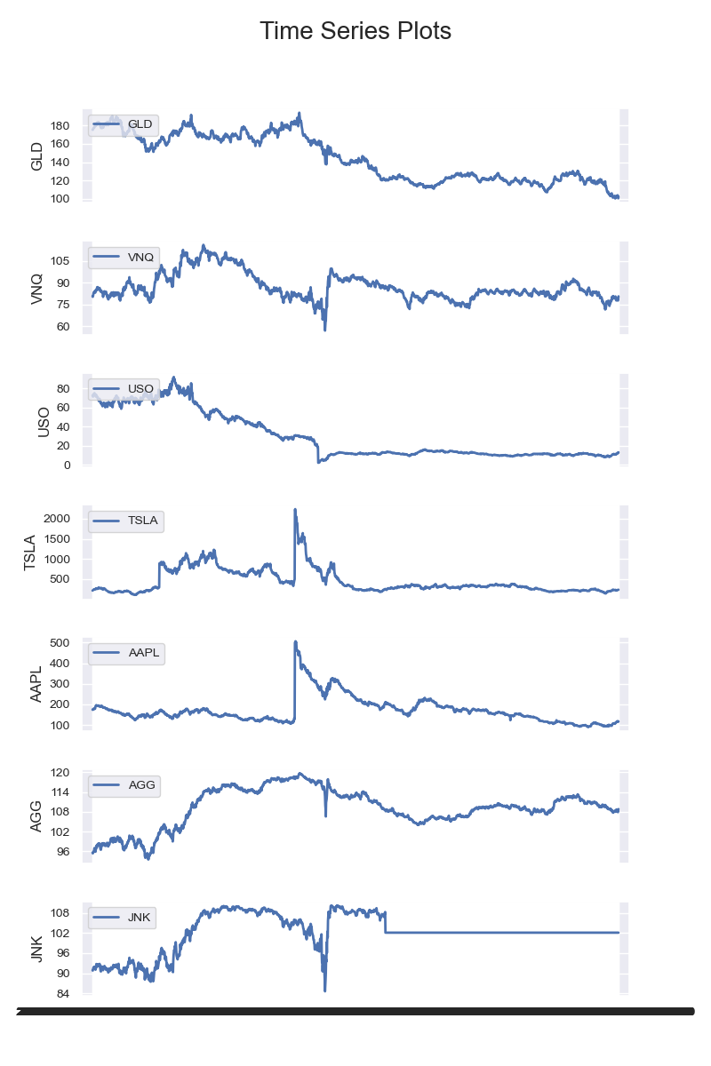
Time Series Analysis
observing long term trends and investor behavior
Gold as a safe haven - upwards trend in Gold during periods of market turbulence suggest that investors turned to gold during uncertain times, and sudden spikes related to geopolitical events or economic instability
Fluctuations in Oil market dynamics related to OPEC decisions, geopolitical tensions, and economic growth affecting oil prices - energy market conditions
TSLA and APPL trends can provide insight into technology sector overall health, indicating robust consumer demand
Notes:
Justin

Slide 11
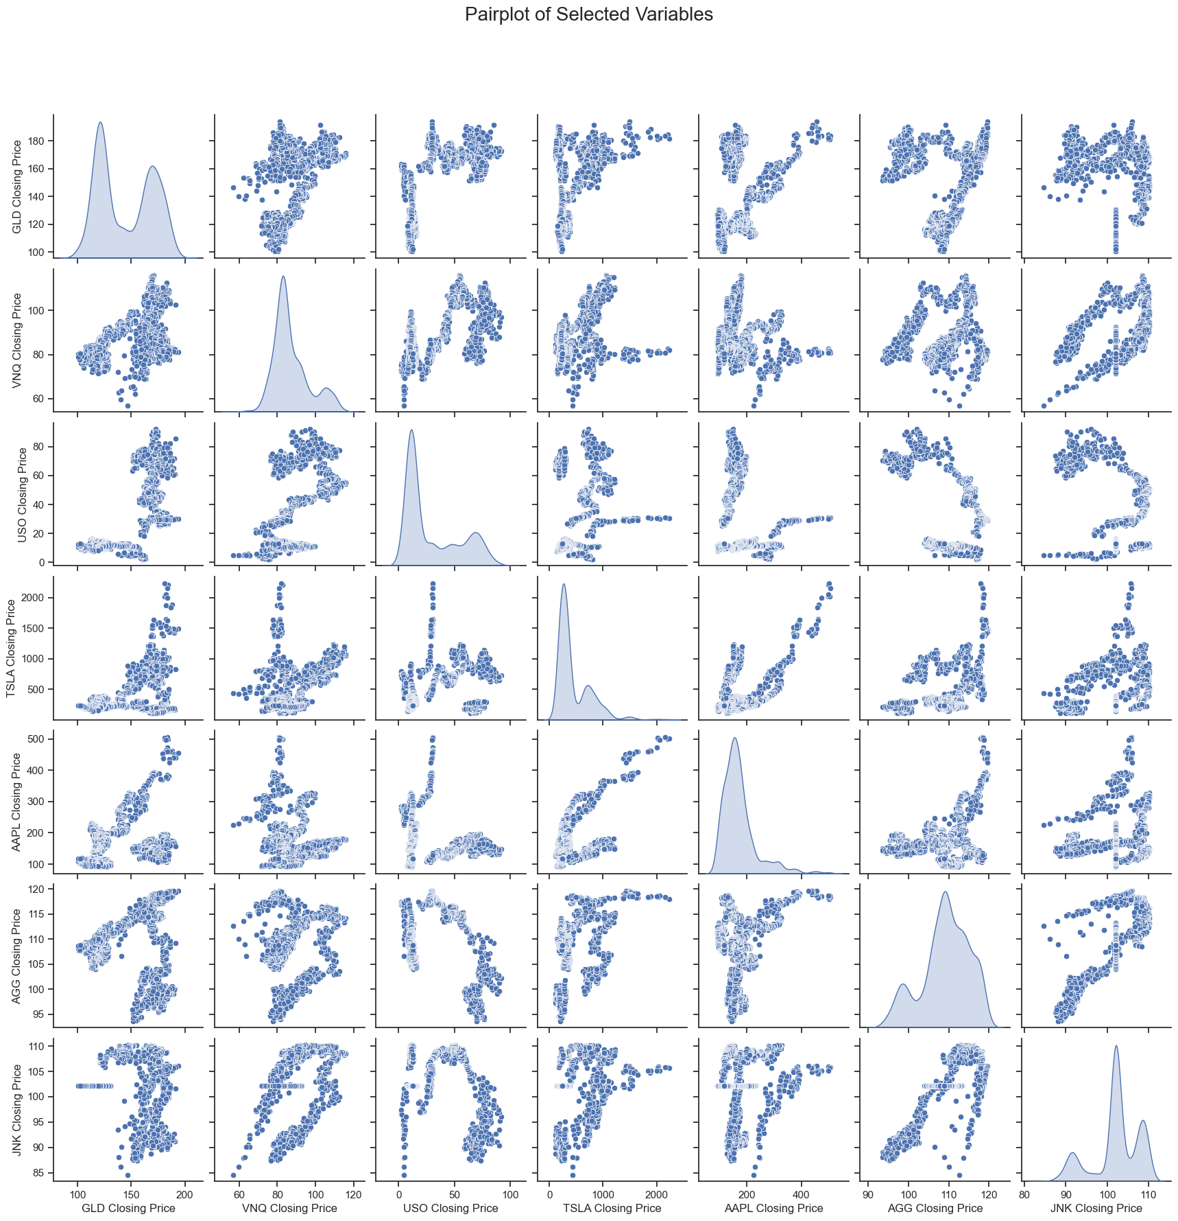
Pairplot
Visual exploration of relationships and trends between pairs of variables
GLD (Gold) and AGG (Aggregate Bond) exhibit smooth distributions, while TSLA (Tesla) and AAPL (Apple) display varied distributions
GLD and AGG exhibit a positive linear relationship, representing a potential safe haven for market uncertainties
USO (Oil) and VNQ (Real Estate) show dispersed points, suggesting volatility
Notes:
Justin

Slide 12
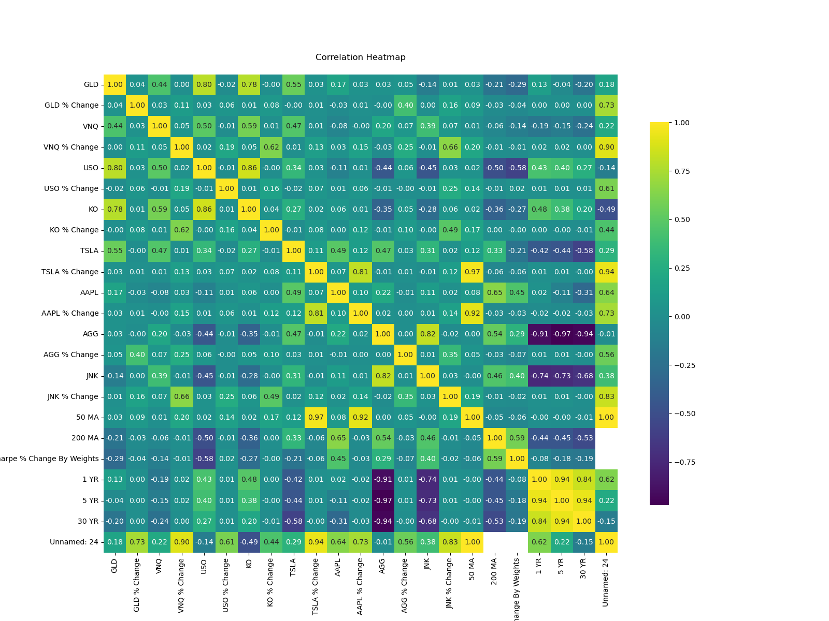
Pairwise Correlation Heatmap
Identify multicollinearity between independent variables
Strong positive correlation between GLD (Gold) and AGG (Aggregate Bond_
Significant negative correlation between TSLA (Tesla) and AGG (Aggregate Bond) implying inverse relationship between the performance of tech stocks and the bond market
Low to near zero correlation between VNQ (Real Estate) and USO (Oil)
Notes:
Justin - if two independent variables are highly correlated, we would consider removing one of them to avoid redundancy

Slide 13
0.57
Random Forest Before and After
MODEL 1 Utilizing Dataset 1.0
Our first attempt the predictors using Apples P/E ratio, and 50 and 200 day MA, and included other variables of 1 and 5 year treasury yields and a news score based on sentiment. Running this model resulted in a 57% Precision Score.
0.97- 0.99
After backtesting and manual optimization, we found the logistic regression to yield very high accuracy when predicting the correct BUY or SELL classification.
MODEL 2.0 Utilizing Further Feature Engineering + Dataset 2.0
The second attempt at employing the Random Forest algorithm utilized 8 years of price data. We presented three datasets, each incorporating the "increase" feature options, along with hyperparameters tailored to different configurations. As a result, we achieved an impressive Precision score ranging from 96% to 99%, contingent on the selected hyperparameters.
Notes:
Alin

Slide 14
0.97
Logistic Regression Before and After
MODEL 1 Utilizing Dataset 1.0
Precision | Categorical Cross- Entropy
F1 Score | 1
Recall | 2
Support | “sigmoid”
0.98
MODEL 2.0 Utilizing Further Feature Engineering + Dataset 2.0
After backtesting and manual optimization, we found the logistic regression to yield very high accuracy when predicting the correct BUY or SELL classification.
Precision | Categorical Cross- Entropy
F1 Score | 10
Recall | 2
Support | “sigmoid”
Notes:
Alin

Slide 15
0.5203
Neural Network before and after
MODEL 1 Pre - hyperparameter tuning with Dataset 1.0
Loss Function | Categorical Cross- Entropy
Number of Hidden Nodes | 10
Number of Output Neurons | 2
Optimizer Function | “sigmoid”
0.9677
MODEL 2.0 Utilizing Further Feature Engineering + Dataset 2.0
After backtesting and manual optimization, we found a significant increase in the accuracy score of the model for predicting the correct BUY or SELL classification.
Loss Function | Mean Squared Error
Number of Input Features | 24
Number of Output Neurons | 1
Optimizer Function | “adam”
Notes:
Justin

Slide 16
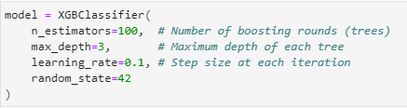
XGBoost
Results utilizing dataset 2.0
1.00
Model | XGBClassifer
Number of Boosting Rounds/Trees | 100
Maximum Depth of each Tree | 3
Learning Rate / Step size of each iteration | 0.1
Random State | 42
This algorithm yielded a resounding accuracy score in discerning the “Buy” or “Sell” signal.
Notes:
Justin

Slide 17






Next Steps
More intricate trading algorithm by incorporating further complexity to enhance predictions
News sentiment, technical indicators, fundamental indicators, etc.
Enhancing feature engineering and selection for all three ML models
fundamental, technical, and macro to improve predictive accuracy
More hyperparameter tuning with the Neural Network
experimenting with different optimizer, loss, activation functions and number of epochs
Notes:
Alin

Slide 18
Questions?

